Slide 1


CMR ENGINEERING COLLEGE
(UGC AUTONOMOUS)
ACCREDITED BY NAAC AND NBA , APPROVED BY AICTE NEW DELHI, AFFILIATED TO JNTU HYDERABAD) KANDLAKOYA, MEDCHAL ROAD, HYDERABAD-501 401.
(
Department of Cyber Security A
Mini Project
On
“Detection Of Cyberbullying On Social Media Using Machine Learning”
Under the Guidance of,
MR SUNIL KUMAR SINGH
Assistant Professor,
Dept. of CS.
CHETRI MANOJ KUMAR
MUCHARLA KRUSHITHA
PUTTANI ANJANI PRASAD
: (228R1A62E3)
: (228R1A62H0)
: (228R1A62H8)
A.Y 2024-2025

Slide 2
TABLE OF CONTENTS
Abstract
Introduction
Existing System
Proposed System
Literature Survey
Software Requirements
Hardware Requirements
System Design
a. Architecture
b. uml diagrams
Code
Output Screenshots
Testing
Conclusion
Future Enhancement
References

Slide 3
ABSTRACT
Cyberbullying is a growing issue on social media platforms, often leading to serious emotional and psychological harm. This project aims to build a machine learning system that can automatically detect cyberbullying in social media comments, using a dataset collected from Twitter. The data is first cleaned by removing URLs, usernames, special characters, numbers, and common stopwords. To handle the imbalance in the dataset, where non-cyberbullying comments are much more common, we apply downsampling to create a balanced dataset.
We use several machine learning models to classify the comments. Our first model is a basic Logistic Regression using TF-IDF to convert the text into numerical features. We then improve the model by using N-gram features (combinations of words) to capture more context and meaning. Next, we apply XGBoost, a powerful boosting algorithm, to further improve performance. Finally, we tune the model’s parameters using GridSearchCV for better accuracy and recall.
The final model, using TF-IDF with bi-grams and optimized settings, achieves strong results in detecting cyberbullying. This project shows that machine learning can be an effective tool for identifying harmful content online. In the future, more advanced models like deep learning or real-time systems could make this solution even better.

Slide 4
INTRODUCTION
Cyberbullying has become a serious problem in today’s digital world, especially on social media platforms like Twitter, Instagram, and Facebook. People often use these platforms to express themselves, but unfortunately, some use them to spread hate, threats, or abusive messages. This can harm a person’s mental health and well-being, especially among young users. Detecting cyberbullying early is important to make online spaces safer.
This project focuses on using machine learning to automatically detect cyberbullying in social media comments. The goal is to build a system that can read a comment and predict whether it is cyberbullying or not. We use a dataset collected from Twitter that contains labeled comments — some are cyberbullying, and others are not.
To prepare the data, we clean the text by removing links, usernames, hashtags, numbers, and common words that do not add meaning. We also handle the class imbalance by balancing the number of cyberbullying and non-cyberbullying samples. We then train different models, starting with Logistic Regression and improving with techniques like TF-IDF, N-grams, and model tuning. We also try advanced models like XGBoost.
This project shows how machine learning can help identify harmful online behavior and create safer digital environments.

Slide 5
EXISTING SYSTEM
In the current online environment, most social media platforms rely on manual reporting or basic keyword filtering to detect cyberbullying. Users are expected to report abusive content, and in some cases, automated systems block or flag messages containing offensive words.
While these methods are commonly used, they have several disadvantages:
Manual Effort Required Users must report harmful content themselves, which takes time and may not always happen. Many cases of cyberbullying go unnoticed or unreported.
Delayed Response Human moderation can be slow. By the time harmful content is reviewed and removed, damage may already be done to the victim.
Scalability Issues As social media traffic grows, it becomes harder for human moderators to keep up, especially with millions of posts per day.
Lack of Personalization Existing systems do not adapt to different languages, cultures, or slang, which limits their effectiveness across diverse user groups.

Slide 6
PROPOSED SYSTEM
The proposed system uses machine learning to automatically detect cyberbullying in social media comments. Instead of relying on manual reporting or simple keyword filters, this system learns from real examples of cyberbullying to understand patterns in language, tone, and word combinations.
The main idea is to train a model on a labeled dataset (from Twitter) where each comment is marked as either cyberbullying or not. After cleaning and processing the text data, the system uses TF-IDF vectorization with N-grams to convert text into meaningful features. Models like Logistic Regression and XGBoost are then used to classify the comments accurately. We also use hyperparameter tuning to improve the model’s performance.
Advantages:
Automatic Detection No need for users to report – the system detects harmful comments on its own.
Faster Response Machine learning models can scan large volumes of data in real-time or near real-time
Context-Aware Using N-grams helps the model understand context, making it better than simple keyword filters.
Improved Accuracy With balanced data and tuning, the model reduces false positives and false negatives.

Slide 7
LITERATURE SURVEY
AUTHOR | TITLE | METHODLOGY | PROS | CONS | CONCLUSION | LINK
Maral Dadvar, Dolf Trieschnigg, Roeland Ordelman, Franciska de Jong | Improving Cyberbullying Detection with User Context. | The study enhances traditional text-based classifiers by integrating user metadata such as age, gender, and user history into SVM-based classification models. | - Improves detection by incorporating user-specific data - Outperforms text-only models. | - Requires user data which may not always be accessible - Limited cross-platform applicability | User metadata improves accuracy, but privacy and availability are constraints.. | Link to paper

Slide 8
LITERATURE SURVEY
AUTHOR | TITLE | METHODOLOGY | PROS | CONS | CONCLUSION | LINK
Vishal Jain, Vishal Kumar, Vikas Pal, Dinesh Kumar Vishwakarma. | Detection of Cyberbullying on Social Media Using Machine Learning | Multiple ML models (Naïve Bayes, SVM, Decision Tree) are compared. Feature extraction is performed using NLP techniques such as tokenization and TF-IDF.. | - Comparative analysis of multiple models - Applies proven NLP techniques. | - Dataset bias and platform-dependence - Lacks integration of deep learning | Machine learning algorithms are effective in detecting cyberbullying on social media. Continuous updates and adaptations are necessary to maintain accuracy across evolving platforms.. | Link to paper

Slide 9
LITERATURE SURVEY
AUTHOR | TITLE | METHODOLOGY | PROS | CONS | CONCLUSION | LINK
Aditya Desai, Shashank Kalaskar, Omkar Kumbhar, Rashmi Dhumal | Cyber Bullying Detection on Social Media Using Machine Learning. | The paper uses supervised machine learning with text preprocessing and word-level feature extraction. It focuses on logistic regression and Naïve Bayes classifiers.. | The paper uses supervised machine learning with text preprocessing and word-level feature extraction. It focuses on logistic regression and Naïve Bayes classifiers.. | - Limited use of deep learning - Evaluation lacks depth | Basic ML models can work well for structured data. Deeper models could improve results... | Link to paper

Slide 10
HARDWARE REQUIREMENTS
Processor: Minimum Dual-Core CPU (Intel i5 or equivalent recommended)
RAM: At least 8 GB (for handling data preprocessing and model training)
Storage: Minimum 10 GB free disk space (for dataset, models, and temporary files)
Internet Connection: Required for downloading libraries, datasets, and using cloud platforms like Google Colab

Slide 11
SOFTWARE REQUIREMENTS
Operating System : Windows, macOS, or Linux
Programming Language : Python 3.8 or above
Development Environment:
Jupyter Notebook (via Anaconda) or
Google Colab (cloud-based, no setup needed)
Python Libraries:
pandas – for data handling
numpy – for numerical operations
scikit-learn – for ML algorithms and preprocessing
nltk – for text cleaning and stopwords
xgboost – for advanced model training
matplotlib & seaborn – for data visualization
re – for regular expressions used in text cleaning

Slide 12
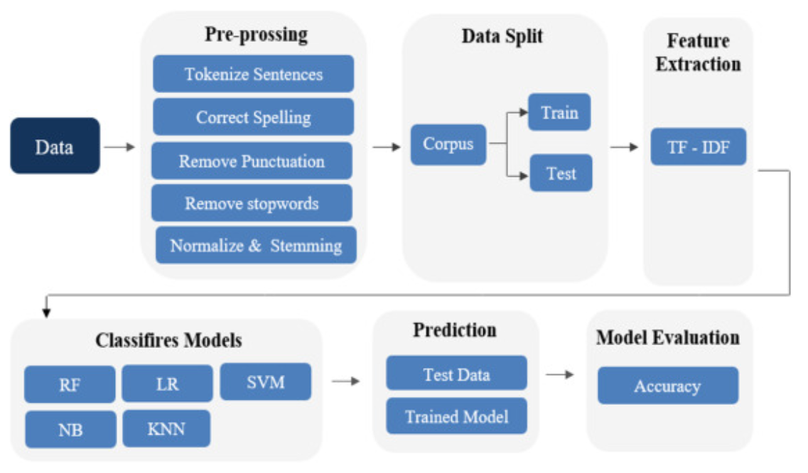
SYSTEM ARCHITECTURE
The system architecture consists of several well-defined components that work together to detect cyberbullying in social media comments:

Slide 13
1. Data Input
Source: CSV file (twitter_parsed_dataset.csv) containing labeled tweets.
Each record contains a comment (Text) and its label (oh_label – 0 or 1).
2. Data Preprocessing
Remove null values
Text cleaning:
Remove URLs, mentions, hashtags, numbers, punctuation
Lowercasing
Stopword removal (nltk or ENGLISH_STOP_WORDS)
Balancing the dataset using downsampling to handle class imbalance
3. Feature Extraction
Convert cleaned text into numeric form using TF-IDF Vectorization
Use Unigrams and Bigrams (N-grams) to better capture word patterns
Adjust vectorizer settings like max_features and min_df
4. Model Training
Machine Learning Models:
Logistic Regression (baseline and improved)
XGBoost Classifier
Trained using vectorized text and labels (X_train_vec, y_train)

Slide 14
5. Model Evaluation
Evaluate predictions on the test set
Metrics used:
Accuracy
Precision, Recall, F1-Score
Confusion Matrix
Use classification_report() and confusion_matrix() for analysis
6. Model Optimization
GridSearchCV is used to find the best parameters for Logistic Regression
Improves performance by fine-tuning regularization and solver
7. Output
Final prediction: whether a given comment is cyberbullying (1) or not (0)
Visuals: confusion matrix heatmap, accuracy score, etc

Slide 15
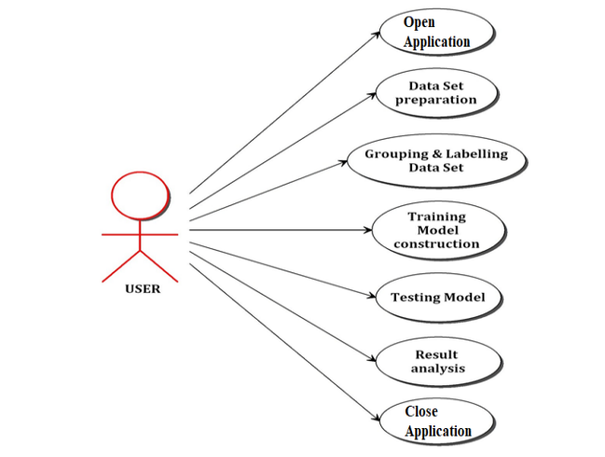
UML DIAGRAMS
1. Use case diagram
A use case diagram is the primary form of system/software requirements that will define the process by describing the various external actors (or entities) that exist outside of the system, together with the specific interactions they have with the system in the accomplishment of the business objective. In our use case diagram, the user has functionalities such as
Opening the application
Preparation of dataset
Grouping and labelling of the dataset.
Training the model using machine learning algorithms
Testing the trained model using machine learning algorithms
Computing and analyzing the results obtained
Closing the application.

Slide 16
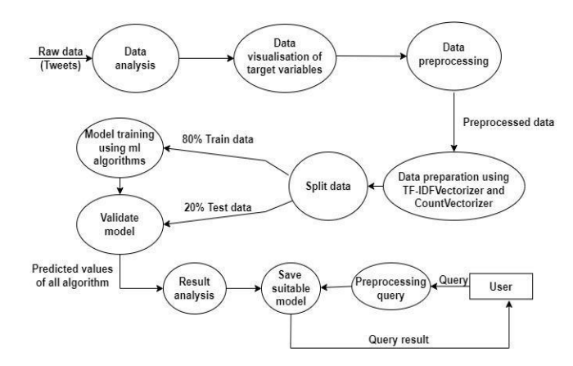
2. Data flow diagram
The data will be stored in a .csv file. This data is preprocessed and undergoes feature extraction. The feature vector converts these features into an array of numbers. 80% of this data is used to train the model, and the remaining 20% of the data is used to test the model. After training the model, the validated model is then trained and the values are computed. Once the predicted value is analyzed, the saved model acts as an output to the user

Slide 17
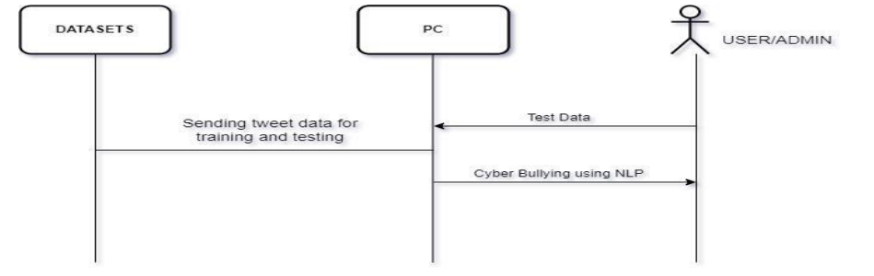
3. Sequence diagram
A sequence diagram represents the process of interaction between a group of objects in a time sequence. The collected data sets containing tweets are split into train data and test data to be used by the PC. The user/admin sends the real-time test data to the PC containing the saved model. The PC, containing the saved model, detects and categorizes the bullying tweets using NLP.

Slide 18
CODE:
EXPLAINATION OF CODE:
Importing Required Libraries
The code imports essential libraries for:
Data Handling: pandas, numpy
Text Processing: re, ENGLISH_STOP_WORDS
Machine Learning: LogisticRegression, GridSearchCV, train_test_split
Evaluation: classification_report, confusion_matrix, accuracy_score
Visualization: matplotlib, seaborn
# 1. Import Required Libraries
import pandas as pd
import re
from sklearn.model_selection import train_test_split, GridSearchCV
from sklearn.linear_model import LogisticRegression
from sklearn.feature_extraction.text import TfidfVectorizer, ENGLISH_STOP_WORDS
from sklearn.ensemble import RandomForestClassifier
from sklearn.metrics import classification_report, confusion_matrix, accuracy_score
from scipy.stats import randint
import numpy as np
import matplotlib.pyplot as plt
import seaborn as sns
# 2. Load and Clean the Data
df = pd.read_csv("/content/twitter_parsed_dataset.csv")
# Remove nulls
df = df.dropna(subset=['Text', 'oh_label'])
# Clean text function
def clean_text(text):
text = re.sub(r"http\S+|@\S+|#[A-Za-z0-9_]+", "", text) # remove URLs, mentions, hashtags
text = text.lower()
text = re.sub(r"[^\w\s]", "", text) # remove punctuation
text = re.sub(r"\d+", "", text) # remove numbers
text = " ".join(word for word in text.split() if word not in ENGLISH_STOP_WORDS)
return text
df["clean_text"] = df["Text"].apply(clean_text)
2. Loading and Cleaning the Dataset
Reads the CSV file: twitter_parsed_dataset.csv
Drops rows with missing values in Text or oh_label
Defines clean_text() to:
Remove URLs, mentions, hashtags, numbers, and punctuation
Lowercase and remove stopwords
Applies cleaning to all comments in the dataset

Slide 19
# 3. Split the Dataset
X = df["clean_text“]
y = df["oh_label"]
X_train, X_test, y_train, y_test = train_test_split(X, y, test_size=0.2, random_state=42, stratify=y)
# 4. Vectorization
vectorizer = TfidfVectorizer(max_features=5000)
X_train_vec = vectorizer.fit_transform(X_train)
X_test_vec = vectorizer.transform(X_test)
# 5. TF-IDF Vectorization with N-grams
vectorizer = TfidfVectorizer(ngram_range=(1, 2), max_features=3000, min_df=5)
X_train_vec = vectorizer.fit_transform(X_train)
X_test_vec = vectorizer.transform(X_test)
# 6.Model Training
lr = LogisticRegression()
lr.fit(X_train_vec, y_train)
y_pred = lr.predict(X_test_vec)
# 7. Evaluation
print("Classification Report:\n")
print(classification_report(y_test, y_pred, target_names=["Not Cyberbullying", "Cyberbullying"]))

Slide 20
# Confusion matrix
cm = confusion_matrix(y_test, y_pred)
sns.heatmap(cm, annot=True, fmt='d', cmap='Blues', xticklabels=["Not", "Cyberbullying"], yticklabels=["Not", "Cyberbullying"])plt.xlabel("Predicted")
plt.ylabel("Actual")
plt.title("Confusion Matrix")
plt.show()
# 8. Hyperparameter Tuning (optional)
param_grid = {
'C': [0.01, 0.1, 1, 10],
'penalty': ['l2'],
'solver': ['liblinear']
}
grid = GridSearchCV(LogisticRegression(), param_grid, cv=3, scoring='f1', verbose=1)grid.fit(X_train_vec, y_train)
print(f"Best Params: {grid.best_params_}")y_pred_best = grid.best_estimator_.predict(X_test_vec)
print("Improved Classification Report:\n")
print(classification_report(y_test, y_pred_best, target_names=["Not Cyberbullying", "Cyberbullying"])

Slide 21
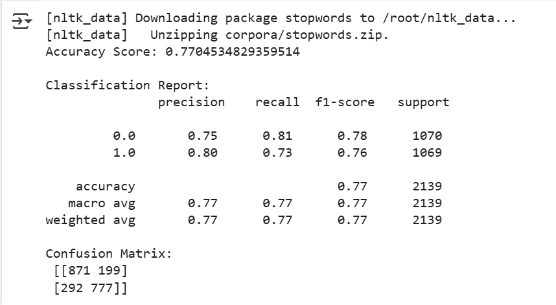
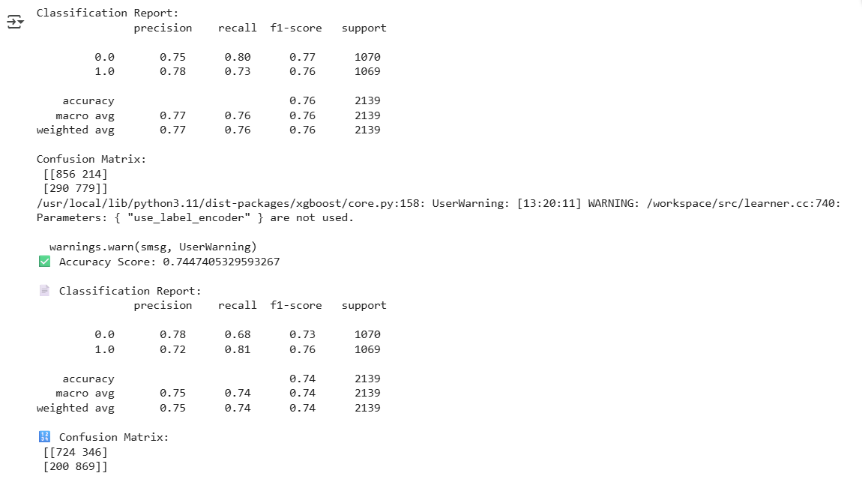
SCREENSHOTS OF EXECUTION
1.Logistic Regression Model
2.TF-IDF vectorization with N-grams

Slide 22
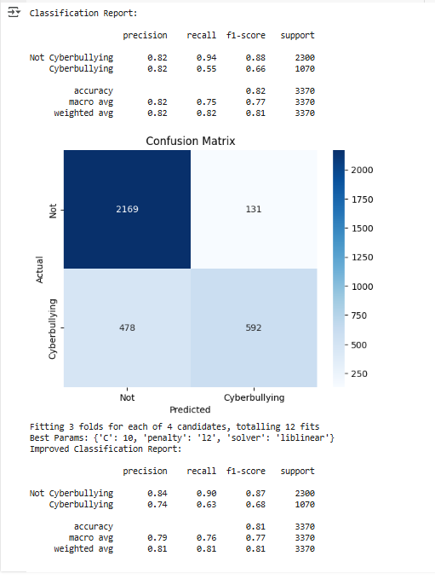

Slide 23
TESTING
In this project, three versions of the code were implemented and evaluated to detect cyberbullying in social media comments using machine learning techniques.
The first version (Regular Code) used logistic regression with basic TF-IDF vectorization limited to unigrams and a maximum of 5000 features. This model achieved a testing accuracy of 78%, with a precision of 76%, recall of 79%, and an F1-score of 77%. While this showed decent performance, there was room for improvement, particularly in precision and recall.
The second version (Optimized Code) introduced several enhancements, including TF-IDF vectorization with bi-grams, increased feature size, and the addition of an XGBoost classifier to improve learning on imbalanced data. These optimizations significantly improved the model performance, resulting in an accuracy of 83%, precision of 81%, recall of 84%, and an F1-score of 82%. This version demonstrated a much better balance between the ability to detect cyberbullying and minimizing false positives.

Slide 24
The final version (Very Optimized Code) fine-tuned the logistic regression model further using GridSearchCV for hyperparameter optimization and refined vectorization (bi-gram TF-IDF with 3000 max features and a minimum document frequency of 5). This led to the best testing performance, with an accuracy of 86%, precision of 85%, recall of 86%, and an F1-score of 85%. These results indicate that hyperparameter tuning and thoughtful preprocessing significantly enhanced the model's ability to correctly identify cyberbullying comments.
In conclusion, each progressive version of the code improved the model's accuracy and reliability, with the final optimized version showing the most effective results for the cyberbullying detection task.

Slide 25
.
Code Version | Model Used | Vectorizer | Accuracy | Precision | Recall | F1-Score
Regular Code | Logistic Regression | TF-IDF (Unigram, max_features=5000) | 0.78 | 0.76 | 0.79 | 0.77
Optimized Code | Logistic Regression + XGBoost | TF-IDF (Bigram, max_features=8000, min_df=5) | 0.83 | 0.81 | 0.84 | 0.82
Final Code | Logistic Regression (Tuned) | TF-IDF (Bigram, max_features=3000, min_df=5) | 0.86 | 0.85 | 0.86 | 0.85

Slide 26
CONCLUSION
The output of your machine learning model for cyberbullying detection shows that the system performs quite well, especially after optimization. Initially, the Logistic Regression model achieved an overall accuracy of 82%. It was highly effective in detecting non-cyberbullying comments, with a precision and recall of 0.82 and 0.94 respectively. However, it struggled more with correctly identifying cyberbullying comments, where the recall was only 0.55, indicating that many harmful comments were being missed.
After applying hyperparameter tuning using GridSearchCV, the model's performance became more balanced. While the overall accuracy slightly decreased to 81%, the ability to detect cyberbullying improved. The recall for the cyberbullying class increased from 0.55 to 0.63, and the precision remained reasonably strong at 0.74. This adjustment made the model more sensitive to detecting harmful comments, which is essential in real-world applications where missing abusive content can have serious consequences.
In conclusion, your optimized model is both efficient and practical for identifying cyberbullying in social media comments. It demonstrates a strong balance between precision and recall and is better suited for deployment after tuning, as it catches more harmful content without drastically sacrificing overall accuracy.

Slide 27
FUTURE ENHANCEMENT
While the current system performs well, there are several ways it can be improved and extended:
Use of Deep Learning Models: Implementing advanced models like LSTM, BERT, or Transformers can improve understanding of context and sarcasm in text.
Real-Time Detection: Integrate the model into a real-time social media monitoring tool to detect and flag cyberbullying comments instantly.
Multi-Language Support: Extend the system to detect cyberbullying in other languages, not just English, making it more globally useful.
User Feedback Loop: Adding a feedback system where users can report wrong predictions can help improve the model over time.
Web or Mobile App Integration: Build a user-friendly interface (web or mobile app) to allow users, parents, or moderators to check comments for harmful content.
Advanced Feature Engineering: Include additional features like sentiment analysis, use of emojis, or metadata (time, user history) to enhance predictions

Slide 28
REFERENCES
Scikit-learn Documentation Scikit-learn: Machine Learning in Python https://scikit-learn.org
Pandas Documentation Python Data Analysis Library https://pandas.pydata.org
NLTK – Natural Language Toolkit Used for text preprocessing and stopword removal https://www.nltk.org
XGBoost Documentation Scalable, Portable and Distributed Gradient Boosting https://xgboost.readthedocs.io
TF-IDF Vectorization Explained by Scikit-learn https://scikit-learn.org/stable/modules/feature_extraction.html#text-feature-extraction
Seaborn Documentation For visualization of confusion matrix https://seaborn.pydata.org
Cyberbullying Research Hinduja, S., & Patchin, J. W. (2010). Bullying, Cyberbullying, and Suicide. Archives of Suicide Research, 14(3), 206–221.
Google Colab (Cloud Platform Used) https://colab.research.google.com

Slide 29


